Slide 1
Demo app: Spring Boot Petclinic in AKS

Slide 2
Clone app and push to Image registry
Clone repo
git clone https://github.com/subha-devops-design/petclinic-app.git
Build docker
Needs a Dockerfile!
docker build -t <repository>/<image-name>:<tag> <dockerfile path>
Tag needs to be the same as external registry
Check images locally
docker images
Login and push to external registry
Docker login
Docker push

Slide 3
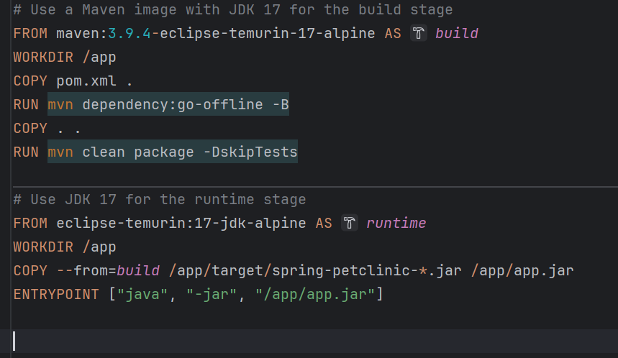
Dockerfile in petclinic

Slide 4
Push to ACR (Azure Kubernete Registry)
Needs to have the correct permissions in azure first!
Login and also show your token:
az acr login --name considdfd
Login to acr with default user
docker login considdfd.azurecr.io
Push image to ACR
Image needs to be tagged with considdfd.azurecr.io/image-name:tag
docker push considdfd.azurecr.io/image-name:tag
You can now use the image in your deployment

Slide 5
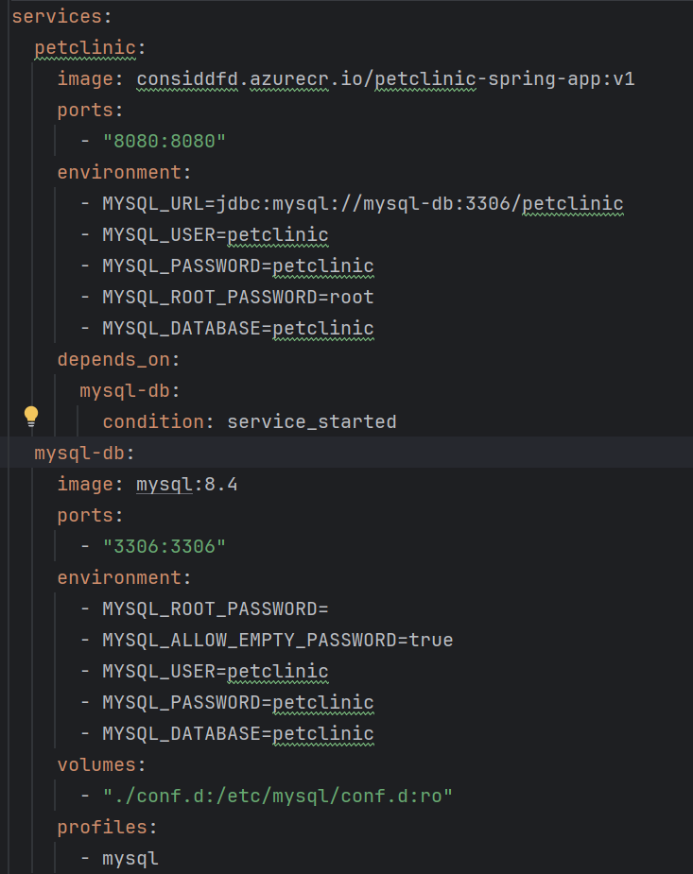
Docker compose in petclinic app

Slide 6
Create a namespace for the app
Create namespace
kubectl create ns dev
Get namespace
kubectl get ns
Switch Namespace
kubectl config set-context --current --namespace=dev

Slide 7
Create Kubernetes objects
Create from kubectl or yaml file
kubectl create <type> <name> <config flags>
kubectl create –f <file path>
Generate yaml from command
kubectl create <type> <name> <config flags> --dry-run=client -o=yaml > myfile.yaml
Now you can modify yaml before creating it, like adding env field for example.

Slide 8
Finding errors
Checkings logs
kubectl logs pod/<name>
Attaching to a pod/container
kubectl exec –it -- bin/sh
Now you can look inside the file system
Show events for resources
kubectl events --types=Warning,Normal
kubectl events --for pod/pod-name --watch
Start a debug copy of a pod keeps pod running even with failed app, to look for errors
Kubectl debug pod

Slide 9
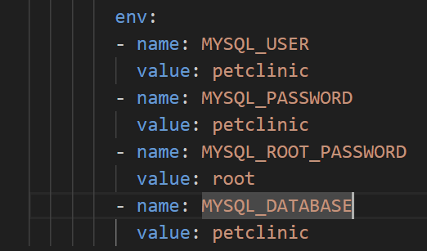
10 minute challenge : Create the database for petclinic
Requirements
Env inside deployment should be
Create a deployment for the database of the app:
Image=mysql:8.4
Name=mysql-db
Port=3306
Use a suitable kubectl command and then modify the yaml to set the env fields.
https://kubernetes.io/docs/reference/generated/kubectl/kubectl-commands#-em-deployment-em-

Slide 10
10 minute challenge: Create Cluster IP service
Requirements
Name: mysql-service
Port: 3306
Target-Port: 3306
Type: ClusterIP
https://kubernetes.io/docs/reference/generated/kubectl/kubectl-commands#expose

Slide 11
10 min challenge check status of db
Find your pod name and then use the commands below!
kubectl exec -it mysql-db-7d8cf944c-mcvnq -- bin/sh sh-5.1# ls afs boot docker-entrypoint-initdb.d home lib64 mnt proc run srv tmp var bin dev etc lib media opt root sbin sys usr sh-5.1# mysql -u root -p Enter password: Welcome to the MySQL monitor. Commands end with ; or \g. Your MySQL connection id is 28 mysql> SHOW DATABASES;

Slide 12
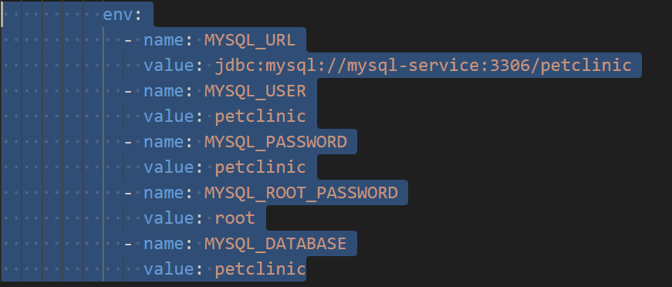
10 minute challenge : Create petclinic app!
Requirements
Env inside deployment should be
Create a deployment for the frontend of the app:
Image=considdfd.azurecr.io/petclinic-spring-app:v1
Name=petclinic-app
Port=8080
Use a suitable kubectl command and then modify the yaml to set the env fields.
https://kubernetes.io/docs/reference/generated/kubectl/kubectl-commands#-em-deployment-em-

Slide 13
10 minute challenge: Create LoadBalancer service
Requirements
Name: petclinic-service
Port: 8080
Target-Port: 8080
Type: LoadBalancer
https://kubernetes.io/docs/reference/generated/kubectl/kubectl-commands#expose

Slide 14
20 minute challenge: Check status of Petclinic app
Show the logs!
kubectl logs deploy/petlinic-app
Check the Loadbalancer service
Do we have an external IP?
Kubectl describe svc petclinic-service
Can we reach the app?
Learn how to check status of you app here: https://medium.com/@subhasmitadas696/step-by-step-guide-to-deploying-the-spring-pet-clinic-app-in-kubernetes-0729f6322098
Start from chapter: Basic Checks to Perform:

Slide 15
Note about liveness and Readiness state
During container startup a pod is marked as running and healthy, this is a problem because:
The state is missleading, the app might still fail during startup….
Traffic might be routed to app while its not ready yet
We want kubernetes to mark the app as ”not ready” when app is starting
Pods are removed fom service endpoints when app is marked as not ready
The app might be in a running state but is not responding to request
Then we need to flag it as unhealthy and restart the pods
We do this check continously

Slide 16
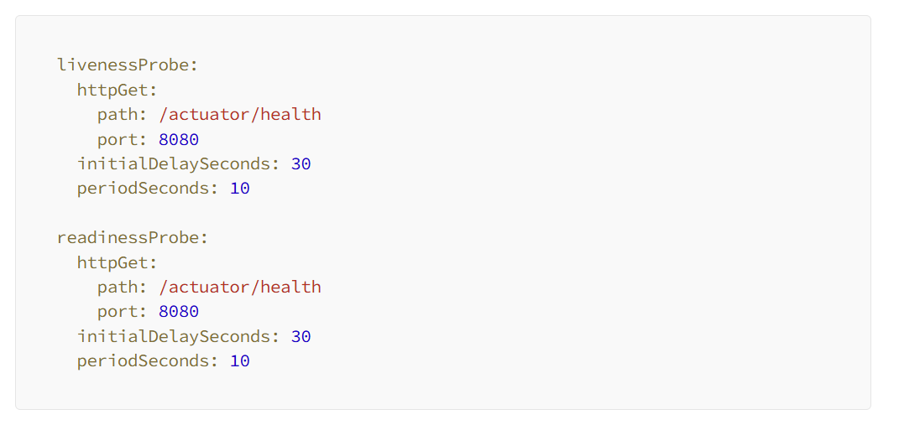
Example liveness/readiness
App will restart if this endpoint
stops responding in runtime!
We can add a custom endpoint for
Better checks, for example ping database
Contiously.
App is no marked as ready until
endpoint pass!
Runs only during startup!
No traffic to app!
We can add custom checks to check
If other systems are ready too!

Slide 17
Link to examples
Petclinic app: https://medium.com/@subhasmitadas696/step-by-step-guide-to-deploying-the-spring-pet-clinic-app-in-kubernetes-0729f6322098

